Slide 1
Mountainboard - Lesson 8
Final Assembly
School’s Name
Teacher’s Name
Date

Slide 2
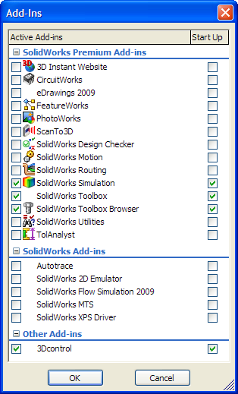
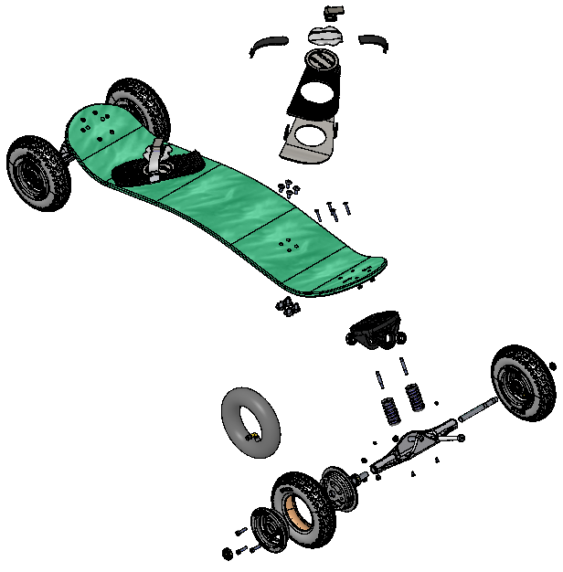
Final Assembly

Slide 3





Smart Mates
Hold the Alt key while dragging a face, edge or vertex
  2 linear edges – Coincident
  2 planar faces – Coincident
  2 vertices - Coincident
  2 conical or cylindrical faces – Concentric
  2 circular edges - Coincident and Concentric

Slide 4
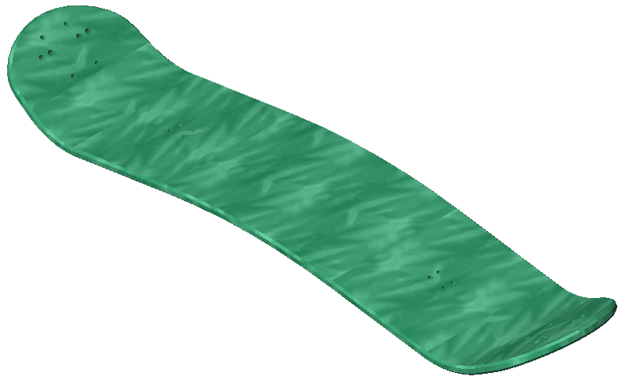
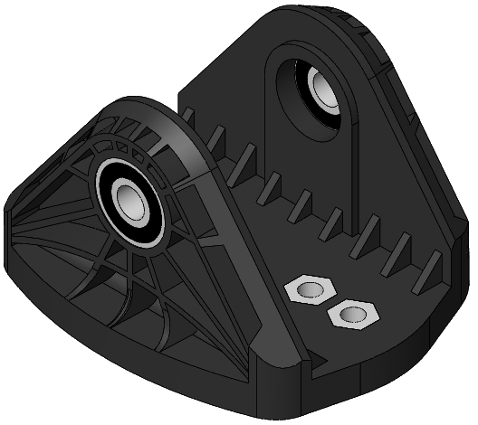
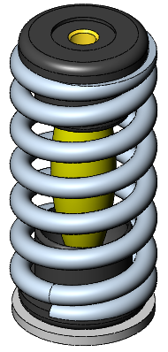
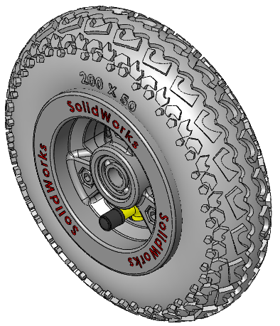
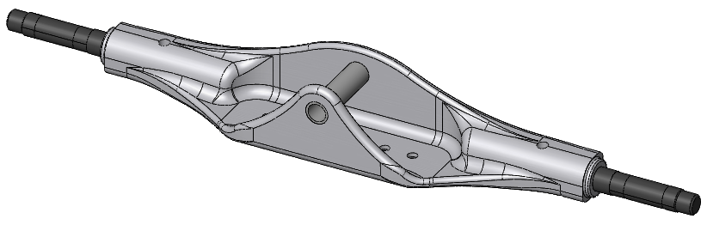
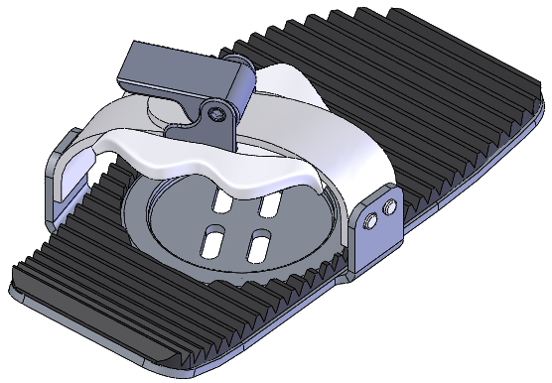
Sub-assemblies
Start with smallest assemblies and work up to main assembly

Slide 5
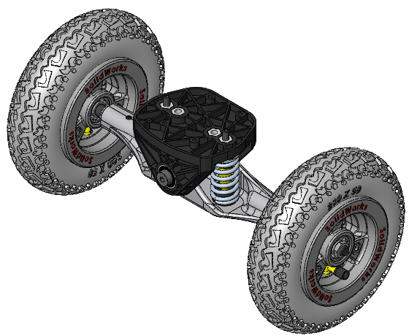
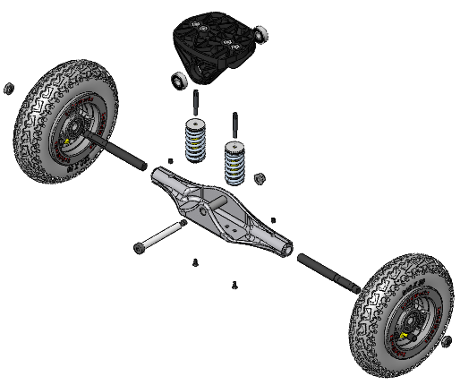
Truck_Axle_Wheel Assembly
Truck Assembly
Spring Assembly
Axle Assembly
Wheel Assembly

Slide 6
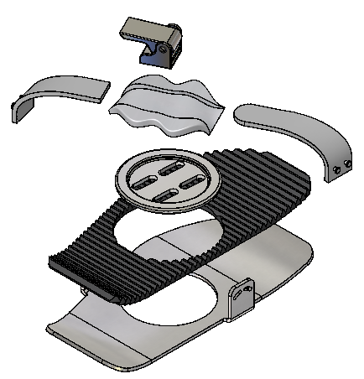
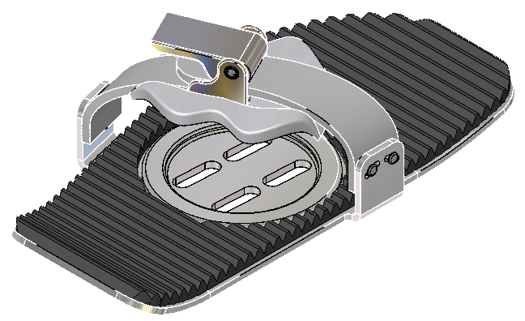
Binding Assembly

Slide 7
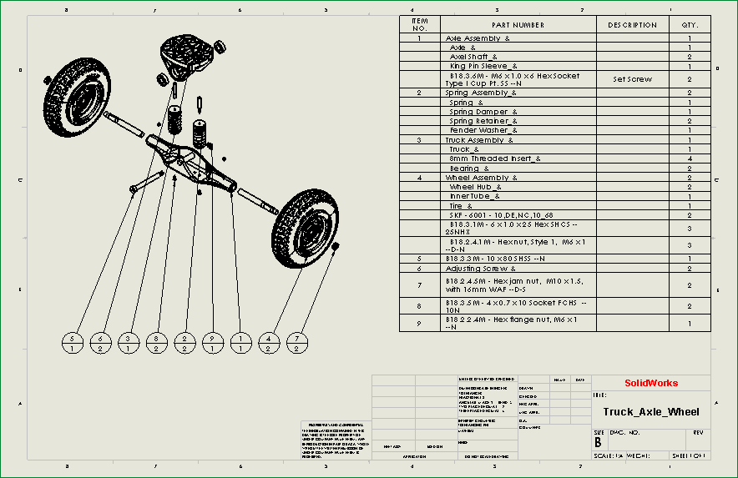
Assembly Drawings
BOM - Bill of Materials
Balloons

Slide 8
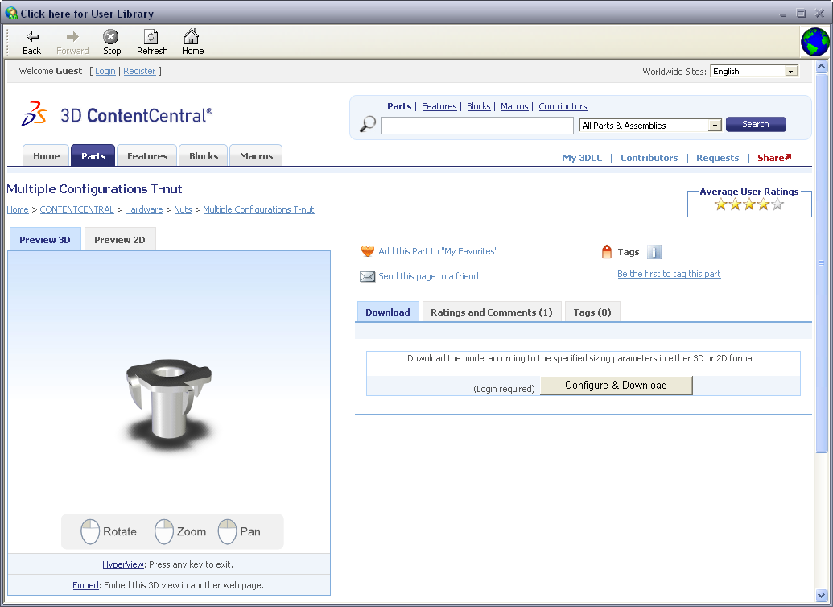
3D Content Central
Online source of 3D models from component suppliers and individuals

Slide 9
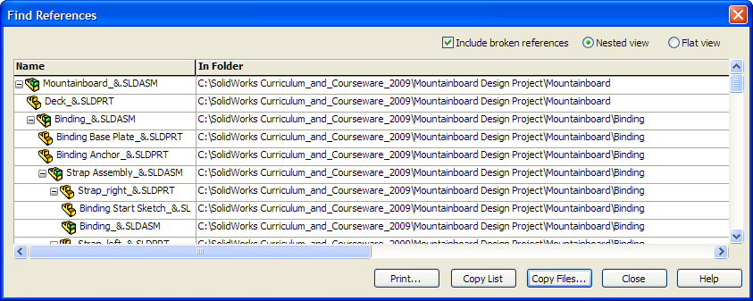
Find References
Locates the files being used by an assembly or drawing

Slide 10
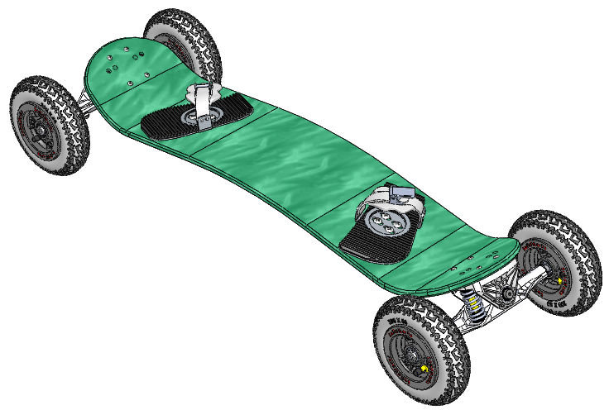
Assembled Mountainboard

Slide 11
Exploded Mountainboard

